Slide 1
UNIT I – INTRODUCTION TO DBMS

Slide 2
Introduction to DBMS
Data can be defined as raw fact that could be recorded.
(Text, number, video, speech, image, audio)
Database is a organized collection of related data which has an implicit meaning.
Information: Arranged form of data is called information.
A database management system (DBMS) is a software package designed to define, manipulate, retrieve and manage data in a database.
Some of databses are MySQL, SQL, Server, Oracle, dBASE, FoxPro, MS-Access etc.

Slide 3
Importance of DBMS
It manages data efficiently and allows user to manage data easily.
It stores, organizes and manages a large amount of information within a single software application.
It provide a highly efficient method for handling multiple types of data.
It is tedious and time consuming to handle data manually.
Multiple users can use the system at the same time in different ways.

Slide 4
Advantages of DBMS
Redundancy control: Redundancy refers to repeated instances of the same data.
A student may have his phone number and address stored in multiple places like in accounts, administration, library
It causes wastage of disk space, anomalies, and inconsistency
Database system used normalization and keys to control redundancy
Inconsistency Control: values of same data may no longer agree
The address of student may be different in different files
Normalization and constraints help to control inconsistency

Slide 5
Advantages of DBMS
Flexibility: database schema can be easily changed to incorporate any new changes in requirements.
Backup and recovery: DBMS provides facility of backing up the data and recovering from hardware or software failures
Integrity constraints: database system satisfies integrity constraints like primary keys, data type, etc. to ensure accuracy consistency and reliability of databases.
Concurrent/multiple users: multiple users can access the system at the same time
Like in QFX, air ticket reservation system

Slide 6
Disadvantages of DBMS
Cost of Hardware and Software of a DBMS is quite high which increases the budget of your organization.
Most database management systems are often complex systems, so special training may need for user.
In some organizations, all data is integrated into a single database which can be damaged because of electric failure or database is corrupted on the storage media.
Use of the same program at a time by many users sometimes lead to the loss of some data.
DBMS can't perform sophisticated calculations

Slide 7
Database Applications
Banking: all transactions
Airlines: reservations, schedules
Universities: registration, grades
Sales: customers, products, purchases
Manufacturing: production, inventory, orders, supply chain
Human resources: employee records, salaries, tax deductions
Database today are core component of all computer based applications

Slide 8
Database Users
Users are differentiated by the way they interact with the system. They are classified as:
Naïve users – They interact with the system by invoking one of the permanent application programs that have been written previously
They do not have to know about the implementation details
Examples, people accessing database over the web, bank tellers, clerical staff
Application programmers – are the computer professionals who develop application programs and user interfaces
They can use any of the high level languages for the purpose
Sophisticated users – interact with the system either using a database query language or by using tools such as data analysis software
Engineers, Scientist, Analysts
Specialized users – sophisticated users who write specialized database applications like knowledge-base and expert systems

Slide 9
Data Models
Data model may be defined as conceptual framework for describing Data, Data relationships, Data semantics and Data constraints.
Provides a way to describe the design of a database at the physical, logical and view level
Data models show that how the data is connected and stored in the system. It shows the relationship between data and how data is presented to the user
Data model is an abstract thing for describing data, data-relationship and constraints.

Slide 10
Data Models: Types
Relational Model
A collection of tables to represent both data and the relationships among the data.
Each table has multiple columns and each column has a unique name.
Recorded values are atomic values
E-R Model
Entity Relationship Model is a high-level data model
ER Model is diagrammatical representation of the conceptual design of a database
Based on the perception of a real world objects called entities, and of relationships among these objects.

Slide 11
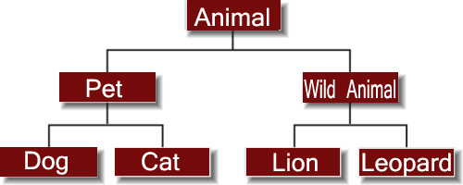
Data Models: Types
Hierarchical Model
It represents the data in a hierarchical tree structure.
Hierarchical model has one parent entity with several children entity and the process goes on
But at the top we should have only one entity called root (parent-child relationship)
It has one to many or many to one relationship

Slide 12
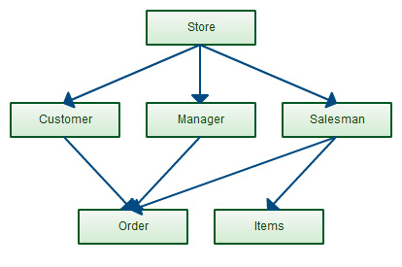
Data Models: Types
Network Model
It is like Hierarchical Model, but the only difference is that it allows a child to have more than one parent
Some entities in the graph can be accessed through several paths
It has many to many relationships as well

Slide 13
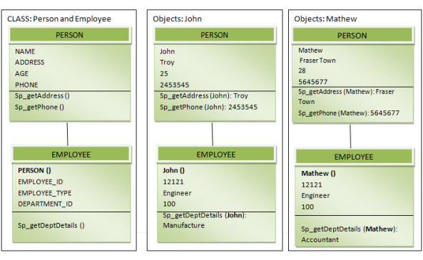
Data Models: Types
Object Oriented Model
It stores the data in the form of objects and classes
Extension of the E-R model with notions of encapsulation, methods and object attributes
This model handles more complex applications, such as GIS, multimedia and scientific modeling

Slide 14
Data Instances and Schemas
Instance (Database state)
the actual content of the database at a particular point in time
Because the databases change over time, the database instance differ at different times
Schema
refers to the overall skeleton of the database, structural description of database.
Physical schema: database design at the physical level
Describes how data is represented and stored in secondary storage using a particular database management system
Logical schema: database design at the logical level.
What data is stored and relationship among data
Defines relational tables, views and constraints

Slide 15
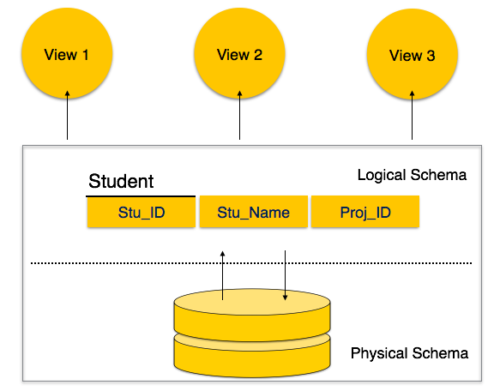
Data Instances and Schemas
View schema: View schema defines database at view level that usually describes end-user interaction with database systems.

Slide 16
Data Independence
The separation of data from the programs that use the data such that any changes made to the data does not need changes in the program is data independence
Application program should be free from the way data is represented and stored
Physical level data independence: It refers to the ability to modify the physical schema without any alterations to the conceptual or logical schema, done for optimization
E.g., Conceptual structure of the database would not be affected by any change in storage size of the database system server.
Changing from sequential to random access files
Utilizing new storage devices.

Slide 17
Data Independence
Logical level data independence: It refers characteristic of being able to modify the logical schema without affecting the external schema or application program.
The user view of the data would not be affected by any changes to the conceptual view of the data.
These changes may include insertion or deletion of attributes, altering table structures or relationships to the logical schema etc. does not affect user’s interactivity.

Slide 18
Three schema architecture/ Data abstraction
The system hides certain details of how the data are stored and maintained and such view is an abstract view.
The Database System provides users with an abstract view of the data.
Data Abstraction:- The database designers use the complex data structure to represent the data in the database and developer hides the complexity from user from several level of abstraction such as physical level, logical level, and view level. This process is called data abstraction.
It hides how exactly data is stored and maintained.

Slide 19
Three schema architecture/ Data abstraction
Physical level (Internal Level)
This is the lowest level of data abstraction.
It tells us how the data is actually stored and organized in memory.
The access methods like sequential or random access.
Size of memory, and the type of memory.
Logical Level (Conceptual level)
Conceptual structure of database, entities and attributes.
It tells what data is exactly stored in the database like the data type.
The relationship among those data.

Slide 20
Three schema architecture/ Data abstraction
View level (External Level)
This is the highest level of data abstraction.
This level exists to ease the accessibility of the database by an individual user.
Simplifies the interaction with the system
The system may provide many views for the same database
Only a part of the actual database is viewed by the user
The main purpose of data abstraction is achieving data independence in order to save time, complexity and cost required when database is modified or altered.

Slide 21
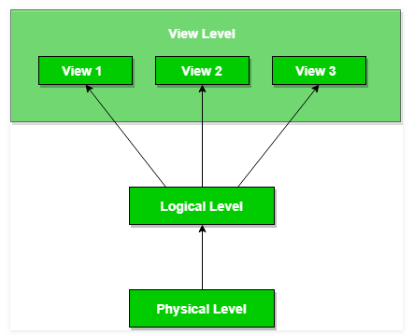
Data Abstraction: Three layers
Figure 1: Three layers of data abstraction

Slide 22
Database Languages
DBMS provides following languages: Data-Definition Language (DDL), Data-Manipulation Language (DML), Transaction control Language (TCL), Data Control Language (DCL), Storage definition language(SDL) and View definition language (VDL).
DDL: is the language used to define and create database schema. It is used in conceptual level.
These statements define the implementation details of the database schema hence usually hidden from the users
CREATE , ALTER, DROP , RENAME and COMMENT are example of DDL statements
They are also used to specify the data structure and integrity constraints
Some of the integrity constraints are:
Domain constraints: decide what type and range of values an attribute can take
Referential integrity: shows relation between two tables, ensures if a value appears in one table also appears in another table.
Because each table in a database must have a primary key, this primary key can appear in other tables because of its relationship to data within those tables.

Slide 23
Database Languages
Assertion: conditions database must always follow. For example age should be in int and name in string.
Authorization: privileges given to different users (read, insert, update or delete authorization)

Slide 24
Database Languages
DML: is the language used by the users to access or manipulate data organized by an appropriate data model (Query Language)
The types of access or manipulations are:
Retrieval of information stored in the database (SELECT)
Insertion of new information into the database (INSERT)
Deletion of information in the database (DELETE)
Modification of information stored in the database (UPDATE)
The common DML commands: SELECT, INSERT, UPDATE, DELETE.

Slide 25
Database Languages
DCL: It stands for data control language. It is used to retrieve the stored or saved data. DCL execution is transactional. For example:
GRANT: it is used to give user access privileges to a database.
REVOKE: it is used to take back permissions from the user.
TCL: It stands for transactional control language and used to manage transaction in the database. These are used to manage the changes made to the data in a table by DML statements. For example:
COMMIT: It is used to save the transaction on the database.
ROLLBACK: It is used to restore the database to the database to original since the last commit.

Slide 26
Database Languages
VDL: It stands for view definition language and it represents user views and their mapping to the conceptual schema.
SDL: It stands for storage definition language and it specifies the mapping between two schemas.

Slide 27
Interface
A database management system interface is a user interface that allows user to input queries to a database without using the query language itself. There are following types of interfaces:
Menu based
Mobile apps
Form based
GUI

Slide 28
Interface
5. Natural language
6. Keyboard
7. Search input and output.
8. Parametric users
9. DBA
Menu-based interfaces for web clients:
These interfaces present the user with list of options called menus that is used for user to request any service.

Slide 29
Interface
Basic advantages of using menus is that they removes the tension of remembering specific command and syntax of any query language.
Form based interface: A form based interfaces displays a form to each user, then user fill out all the given information and matches to the stored data then allows to user to access service.

Slide 30
Interface
Graphical user interface: It uses any graphical symbol or diagram to interact with system.
Natural language interfaces: These interface accept any requests written in english or some other languages .
Interface for parametric users: parametric users such as bank tellers often have a small set of operation that must perform repeatedly so special type of interface is used for them.

Slide 31
Interface
DBA: it stands for database system administrator. There are many commands that are specially for DBA. For example creating account, access control etc.

Slide 32
Database system environment
Database system environment deals with the components of a organization that defines and regulate the collection, storage, management and use of data within a database environment.
Database system is composed of different major parts. Some database system components are as follow:
Hardware
Software
People
Procedure
Data

Slide 33
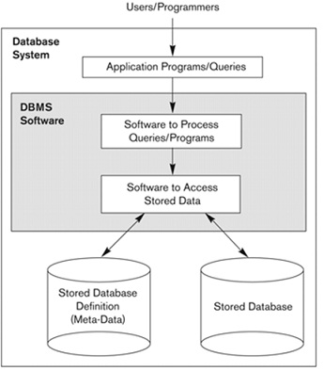
database system environment

Slide 34
Database System Utility
Backup Utility: in case of crashes and disasters this utility helps to take copies of the database periodically.
Monitoring Tools: This tool monitors the performance of internal scheme that can be changed and optimize the data access.
Data loading utility: Data loading utility helps to load data from an external format without writing program.

Slide 35
Database System Utility
Recovery Utility: From the database backup and history of transactions this utility helps in reconstructing the correct state of database.
File organization: this utilities helps in restructuring of data from one type to another.

Slide 36
Application Environment and Communication facilities
The database itself runs in software environment, including the operating system and any programming languages and utilities.
The software depends on underlying hardware to run, including a processing unit, memory and storage.
(Description of components)

Slide 37
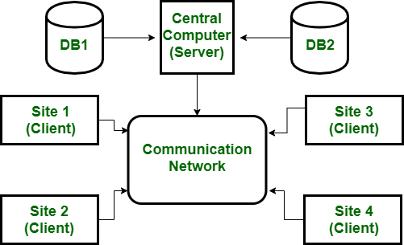
Centralized Architecture
A centralized architecture for DBMS is one in which all data is stored on a single server and all clients connect to that server in order to access and manipulate the data.

Slide 38
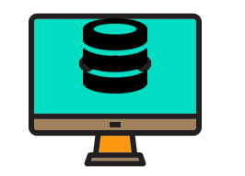
Database Architecture
DBMS architecture helps in design, development, implementation, and maintenance of a database
Selecting the correct Database Architecture helps in quick and secure access to this data.
Main aim is to separate user application from physical database
1-tier architecture:
The Client, Server, and Database all reside on the same machine.
Anytime you install a DB in your system and access it to practice SQL queries it is 1 tier architecture.

Slide 39
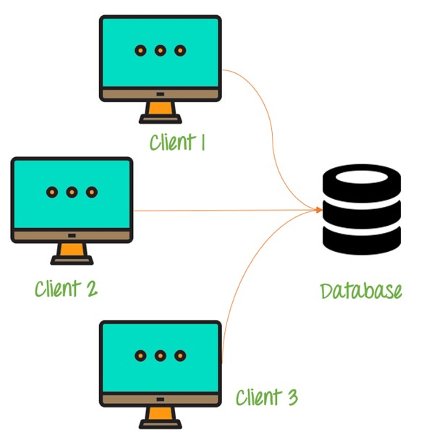
Database Architecture
2-tier architecture:
The two-tier architecture is like client server application.
The direct communication takes place between client and server.
Client system sends the request to the Server system and the Server system processes the request and sends back the data to the Client System
Desktop applications

Slide 40
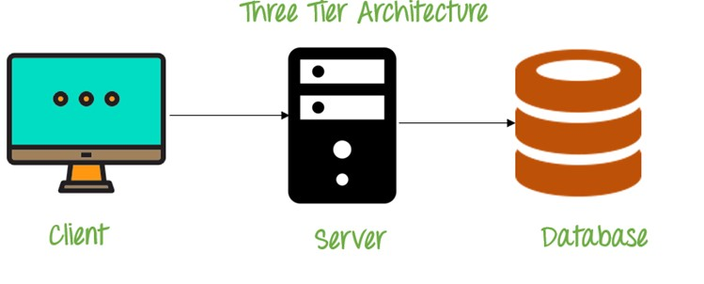
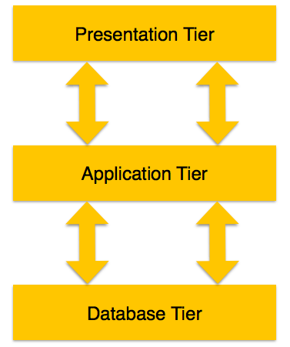
Database Architecture
3-tier architecture: Web applications
Database Tier − At this tier, the database resides along with its query processing languages i.e. dbms itself
Application Tier − the application layer sits in the middle and acts as a mediator between the end-user and the database.
At this tier, the application server and the programs that access the database reside.
User (Presentation) Tier − End-users operate on this tier and they know nothing about any existence of the database beyond this layer.

Slide 41
Classification of database management system
DBMS can be classified based on several criteria , such as:
Based on user numbers
Single user DBMS : It supports one user at a time.
Multi user DBMS : It supports multiple user at a time.
Based on database distribution
Centralized DBMS: Database are stored at a single site and used by many users.
Distributed DBMS: Actual database and the DBMS s/w are distributed from various sites that are connected by network.
Homogeneous distributed DBMS: it uses same software from multiple sites. It can be handled easily. For example: Bank or Organizations DBMS.
Heterogeneous distributed DBMS: It uses different software from different sites
And one common software is used to support data exchange.
Based on Application
General purpose: It is a software system designed to allow the definition, creation, querying, update and administration of database. For example: MYSQL, ORACLE etc.
Special purpose: It doesn’t provide the user with all of the functionality that would be available using a general purpose DBMS. For example An email system

